Slide 1
Helping the Help Desk Help Customers More Helpfully
Sri Kanajan
Senior Data Scientist

Slide 2
What is the Problem?
Hard to find similar Customer Service Requests that have already been resolved to avoid redundant work
Linking Customer Service Requests with TechZone articles are difficult due to the propriety taxonomy in Cisco

Slide 3
Data Sources
Customer Service Requests
Tech Zone Articles
Title:
6509 vrf-lite on sup720-3b
URL:
https://supportforums.cisco.com/discussion/11753751/6509-vrf-lite-sup720-3b
Statistics: Replies: 3 Avg. Rating: Views: 558 Votes: 0 Shares: 0
Description: Geminorum_cco / Mar 4th, 2013
Hi everybody! Thanks for a great resource I've currently got the following layout in my 6509 ...
Step 1 Manually remove the non-CGV6 (CDS TV/IS) configuration.
This is required when you convert an ISM card running CDS TV/IS software to CGv6 and here it’s referring to the XR config, like the service role, service management and service-engine interfaces etc for CDS TV or IS..
Step 2 Getting SW
Install the Cisco IOS XR Software Release 4.2.1 image on the ASR 9000 router including -services- PIE.
Download the install kit asr9k-ism-cgv6-install-kit-4.2.1.00.sh from
https://upload.cisco.com/cgi-bin/swc/fileexg/main.cgi?CONTYPES=IOS-XR.

Slide 4
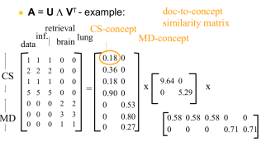
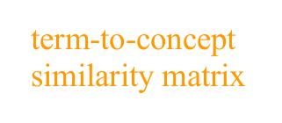
Solution
Extract semantic and topical information from textual and attribute information in order to perform a quantitative similarity analysis between CSC or TZ articles with either query texts or other CSC or TZ articles
Uses Latent Semantic Analysis and TFIDF vectorization

Slide 5
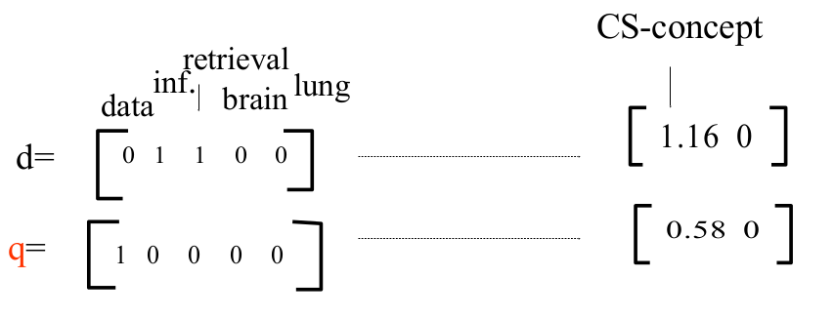
Uses of LSA
Document Similarity
Search Query to
Document Recommendation
TechZone and CSC Summarization

Slide 6
Recommendation
Bring the solution to Large Scale
Text, Concept, Document Weights
Historical CSC Discussions
Query terms or web page visits
TFIDF + Latent Semantic Analysis
(Python/Spark)
Solr
Historical Tech Zone Articles
Similar Resolved CSC,
Italics – Partially Implemented

